Slide 1

CALORIE BURNT PREDICTION
21311A05D2-Dondula Yashasvini
21311A05H9-Devireddy Nandini
21311A05G2- Mohammed Taqreed Azam

Slide 2
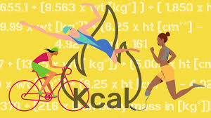
Agenda
Abstract
Introduction
Existing system
Drawbacks
Proposed system
Software and Hardware requirements
References

Slide 3
Abstract
The Calories Burnt Prediction System (CBPS) employs advanced machine learning algorithms to accurately estimate calorie expenditure during various physical activities. Leveraging diverse datasets encompassing a wide range of activity types, durations, intensities, and individual biometric data, CBPS utilizes sophisticated feature engineering techniques to extract relevant information for precise predictions. Real-time monitoring capabilities empower users to dynamically track their calorie expenditure, facilitating informed decision-making in pursuit of fitness goals and overall well-being. By incorporating heterogeneous datasets and employing feature selection techniques, CBPS establishes intricate associations between input parameters and caloric expenditure, enhancing prediction accuracy. With instantaneous feedback on calorie burn rates, users are motivated to engage more actively in fitness activities. Methodologies such as cross-validation and comparison with actual data validate the robustness and reliability of CBPS. In a study comparing machine learning models, XGBoost emerged as the superior choice for predicting calorie burn based on a dataset comprising 15,000 records with seven features, including heart rate, body temperature, and activity duration, achieving an accuracy of 89.5%.Overall, CBPS serves as a valuable tool for individuals, fitness enthusiasts, and healthcare professionals alike, facilitating informed decision-making and fostering a proactive approach to physical fitness and well-being.

Slide 4
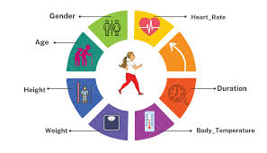

Introduction
The amount of calories burnt depends on internal and external factors, it is subjective and different for everyone depending on their height, weight, and fitness level [1]. Generally, people relate calories to weight or food reduction however it is a quantity of heat energy. From a human perspective, the number of calories is the amount of energy required to carry out a task. Different items have different calorie values related to them.As a human body performs some extensive activity or workout the body temperature and heart rate start rising which leads to the production of heat energy in the body. Which ultimately causes calories to burn. To show the same we take some input parameters such as age, gender, height, and weight and apply different regression algorithms such as linear regression, XG Boost regression, AdaBoost regression, SVR, Decision tree regression, and Random forest regression over the data to get the best and optimal results.

Slide 5
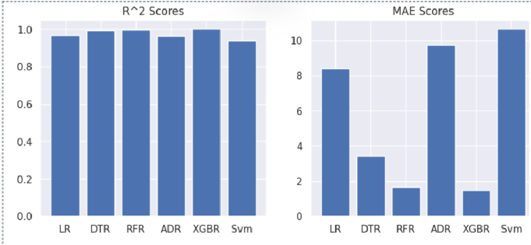
Existing system
Regresssions | Mean absolute error
Linear regression | 8.3851
Decision tree regression | 3.343
Random forest regression | 1.675
Ada boost regression | 8.670
SVR | 10.620

Slide 6

Drawbacks
1. Limited Predictive Power
2. Less Robustness
3. Difficulty Handling Non-linear Relationships
4. Suboptimal Feature Importance Estimation
5. Slower Training and Inference
6. Dependency on Data Quality
7. Difficulty Handling Imbalanced Data

Slide 7
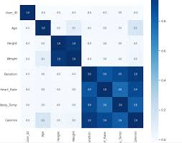
Proposed system
Objective: Integrate XGBoost regressor into the Calories Burnt Prediction System (CBPS) for precise calorie expenditure estimation during physical activities.
Steps:
Data Collection & Preprocessing
Feature Engineering
XGBoost Model Training
Real-Time Monitoring
Validation & Deployment
Benefits:
Empowers informed decision-making in fitness goals
Enhances user engagement and motivation
Facilitates proactive approach to well-being

Slide 8
Software & Hardware Requirements
Software
Hardware
1. Python Programming Language Environment
2. XGBoost Library
3. Pandas for Data Manipulation
4. NumPy for Numerical Operations
5. Scikit-learn for Machine Learning Utilities
6. Matplotlib or Seaborn for Visualization
7. Jupyter Notebook or JupyterLab for Interactive Development
8. Integrated Development Environment (IDE)
9. Version Control System (Optional)
10. Environment Management Tool (Optional)
1. Processor (CPU)
2. Memory (RAM)
3. Storage
4. Graphics Processing Unit (GPU) (optional)
5. Operating System
6. Internet Connection
7. Miscellaneous

Slide 9
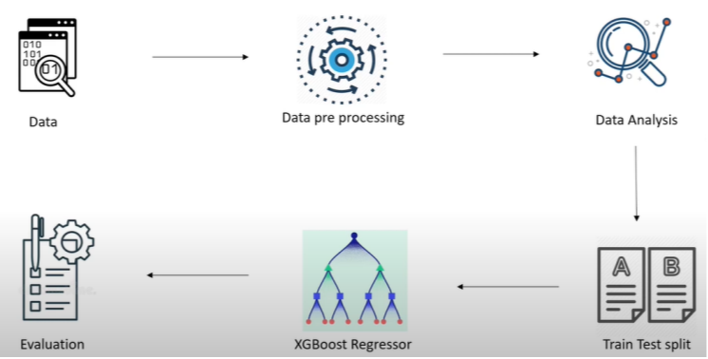

Slide 10
References
Goukens, Caroline, and Anne Kathrin Klesse. "Internal and external forces that prevent (vs. Facilitate) healthy eating: Review and outlook within consumer Psychology." Current Opinion in Psychology (2022): 101328.
Khan, Abdul Wahid, et al. "Factors Affecting Fitness Motivation: An Exploratory Mixed Method Study." IUP Journal of Marketing Management 21.2(2022).
Roberts, K. C., Shields, M., de Groh, M., Aziz, A., & Gilbert, J. A. (2012). Overweight and obesity in children and adolescents: results from the 2009 to 2011 Canadian Health Measures Survey. Health rep, 23(3), 37-41.
Kalpesh, Jadhav, et al. "Human Physical Activities Based Calorie Burn Calculator Using LSTM." Intelligent Cyber Physical Systems and Internet of Things: ICoICI 2022. Cham: Springer International Publishing, 2023. 405-424.
Tayade, Akshit Rajesh, and Hadi Safari Katesari. "A Statistical Analysis to Develop Machine Learning Models: Prediction of User Diet Type.“
Gour, Sanjay, et al. "A Machine Learning Approach for Heart Attack Prediction." Intelligent Sustainable Systems: Selected Papers of WorldS4 2021, Volume 1. Springer Singapore, 2022.
Panwar, Punita, et al. "A Prospective Approach on Covid-19 Forecasting Using LSTM." 2022 International Conference on Fourth Industrial Revolution Based Technology and Practices (ICFIRTP). IEEE, 2022.
Smola, Alex, and S. V. N. Vishwanathan. "Introduction to machine learning." Cambridge University, UK 32.34 (2008): 2008.
Nipas, Marte, et al. "Burned Calories Prediction using Supervised Machine Learning: Regression Algorithm." 2022 Second International Conference on Power, Control and Computing Technologies (ICPC2T). IEEE, 2022.
ITM Web of Conferences 54, 01010 (2023) https://doi.org/10.1051/itmconf/20235401010I3CS-2023

Slide 11
Thank You

